Slide 1
FX Markets

Slide 2
Sections
The structure
The spot market
The forward market

Slide 3
The size of FX markets
Worldwide daily trading of spot and forward FX is about $5 trillion (NYSE trading volume is about $100 billion a day).
Equivalent to $700 in daily transactions for every person on earth.
Spot rate: FX rate/price for immediate (within 2 business days) delivery.
Forward rate: FX rate/price set today but to be settled (delivered) at a future date.

Slide 4
FX markets, I
Ranging from conversion of currencies, bank deposits of foreign currency, the extension of credit denominated in a foreign currency, foreign trade financing, trading in foreign currency forwards, options and futures, and swaps.
Option: a contract giving the owner the right to buy or sell an asset at a specified price at some date in the future.

Slide 5
FX markets, II
Futures: a standardized contract with a future delivery date that is traded on an exchange.
Swaps: two parties make a contractual agreement to exchange cash flows in the future (Chapter 14).
Futures and options are hedging instruments having terms no longer than a few years; swaps can be used to hedge with longer terms.

Slide 6
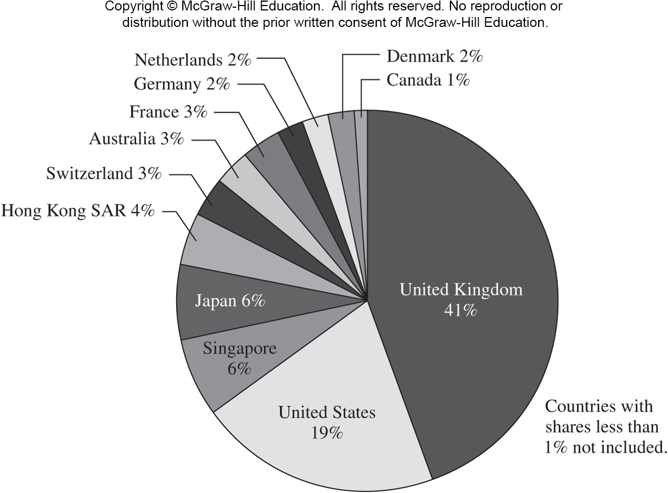
Shares of FX turnover

Slide 7
FX markets, III
The spot and forward FX markets are over-the-counter (OTC) markets.
24-hour-a-day trading.
The largest FX trading center/city: London.
Major FX city in Asia: Singapore.
Major FX city in Europe: London (Brexit introduced uncertainty).
Major FX city in America: NYC.
FX trading is particularly active when the trading hours of major FX cities overlap; e.g., when London and NYC markets are open.

Slide 8
THE capital market in Asia: Singapore?
Another category of businesses already fleeing the encroachment of the Chinese state: Chinese financial interests and family offices that invest on behalf of wealthy mainland individuals who fear scrutiny by Beijing.
"A few big wealth management clients have taken it up seriously, as they consider Singapore as a much more stable place than Hong Kong that is also further away from China," said Steve Knabl, chief operating officer at Swiss-Asia Financial Services, a platform for hedge funds and wealth managers, which administers $3 billion.
Singapore has quietly put in place regulations designed to lure the assets of fund managers and family offices, and is among a growing list of Asian cities vying to make themselves more attractive to international firms leaving or diversifying away from Hong Kong.
Source: Nikkei Asia, 08/2020.

Slide 9
The daily FX market
Source: Sam Y. Cross, All About the Foreign Exchange Market in the United States, Federal Reserve Bank of New York,

Slide 10
FX market participants: 5 groups
International banks (100-200 of them; e.g., Deutsche Bank, Citi, Barclays, UBS): they are often market makers.
Banks customers (e.g., IBM, Ford, money managers)
Nonbank dealers (e.g., Goldman Sachs, Morgan Stanley, hedge funds): they have their own trading rooms to trade in the interbank market; they account for about 40% of the market.
FX brokers: this group is much smaller today because the vast majority of interbank trades flow through Thomson Reuters and ICAP (UK-based) platforms; they match dealer orders to buy and sell currencies for a fee.
Central banks (e.g., the Fed, PBOC)

Slide 11
Two-tier market
Retail or client market
Wholesale or interbank market: the interbank market is a network of correspondent banking relationships.
Correspondent banking relationship: large commercial banks maintaining demand deposit accounts (e.g., saving accounts, checking accounts) with one another.

Slide 12
Correspondent banking relationship
Consider an U.S. importer purchases cars from BMW. The cost is in the amount of €1,000,000.
The importer contacts his bank, TD Bank. TD Bank quotes €/$ = 0.9, or $/€ = 1.1111.
TD Bank debits the importer’s demand deposit account $1,111,100. (TD Bank credits its own books $1,111,100.)
TD Bank instructs BMW’s bank, Deutsche Bank, to debit TD Bank’s correspondent bank account €1,000,000.
Deutsche Bank Credits €1,000,000 to BMW’s account.

Slide 13
Currency symbols
In addition to the familiar currency symbols (£, ¥, €, $) there are three-letter codes for all currencies.
It is a long list, but selected codes include:
CHF Swiss francs
GBP British pound
CNY Chinese yuan
CAD Canadian dollar
JPY Japanese yen
EUR Euro

Slide 14
Spot FX Trading
In the interbank market, the standard size trade is about U.S. $10 million.
A bank trading room is a noisy, active place.
The stakes are high.
The “long term” is about 10 minutes.
Market psychology plays an important role.

Slide 15
Spot rate quotations, I
Direct quotation (from the U.S. perspective): the price of one unit of the foreign currency in (terms of) U.S. dollar.
This is also called quoted in American term (the numerator is $).
Example: spot rate S($/¥) = 0.010094.
Example: spot rate S($/€) = 1.3092.

Slide 16
Spot rate quotations, II
Indirect quotation (from the U.S. perspective): the price of one U.S. dollar in the foreign currency.
Example: S(¥/$) = 99.07 (= 1/0.010094).
Example: S(€/$) = 0.7638 (= 1/1.3092).
The pricing of U.S. dollar quoted in the foreign currency (i.e., indirect quotation from the U.S. perspective) is also called as quoted in European term (the numerator is non-$).
Most currencies in the interbank market are quoted in European terms.
Conventionally, British pound, Australian dollar, New Zealand dollar, and euro are quoted in American terms.

Slide 17
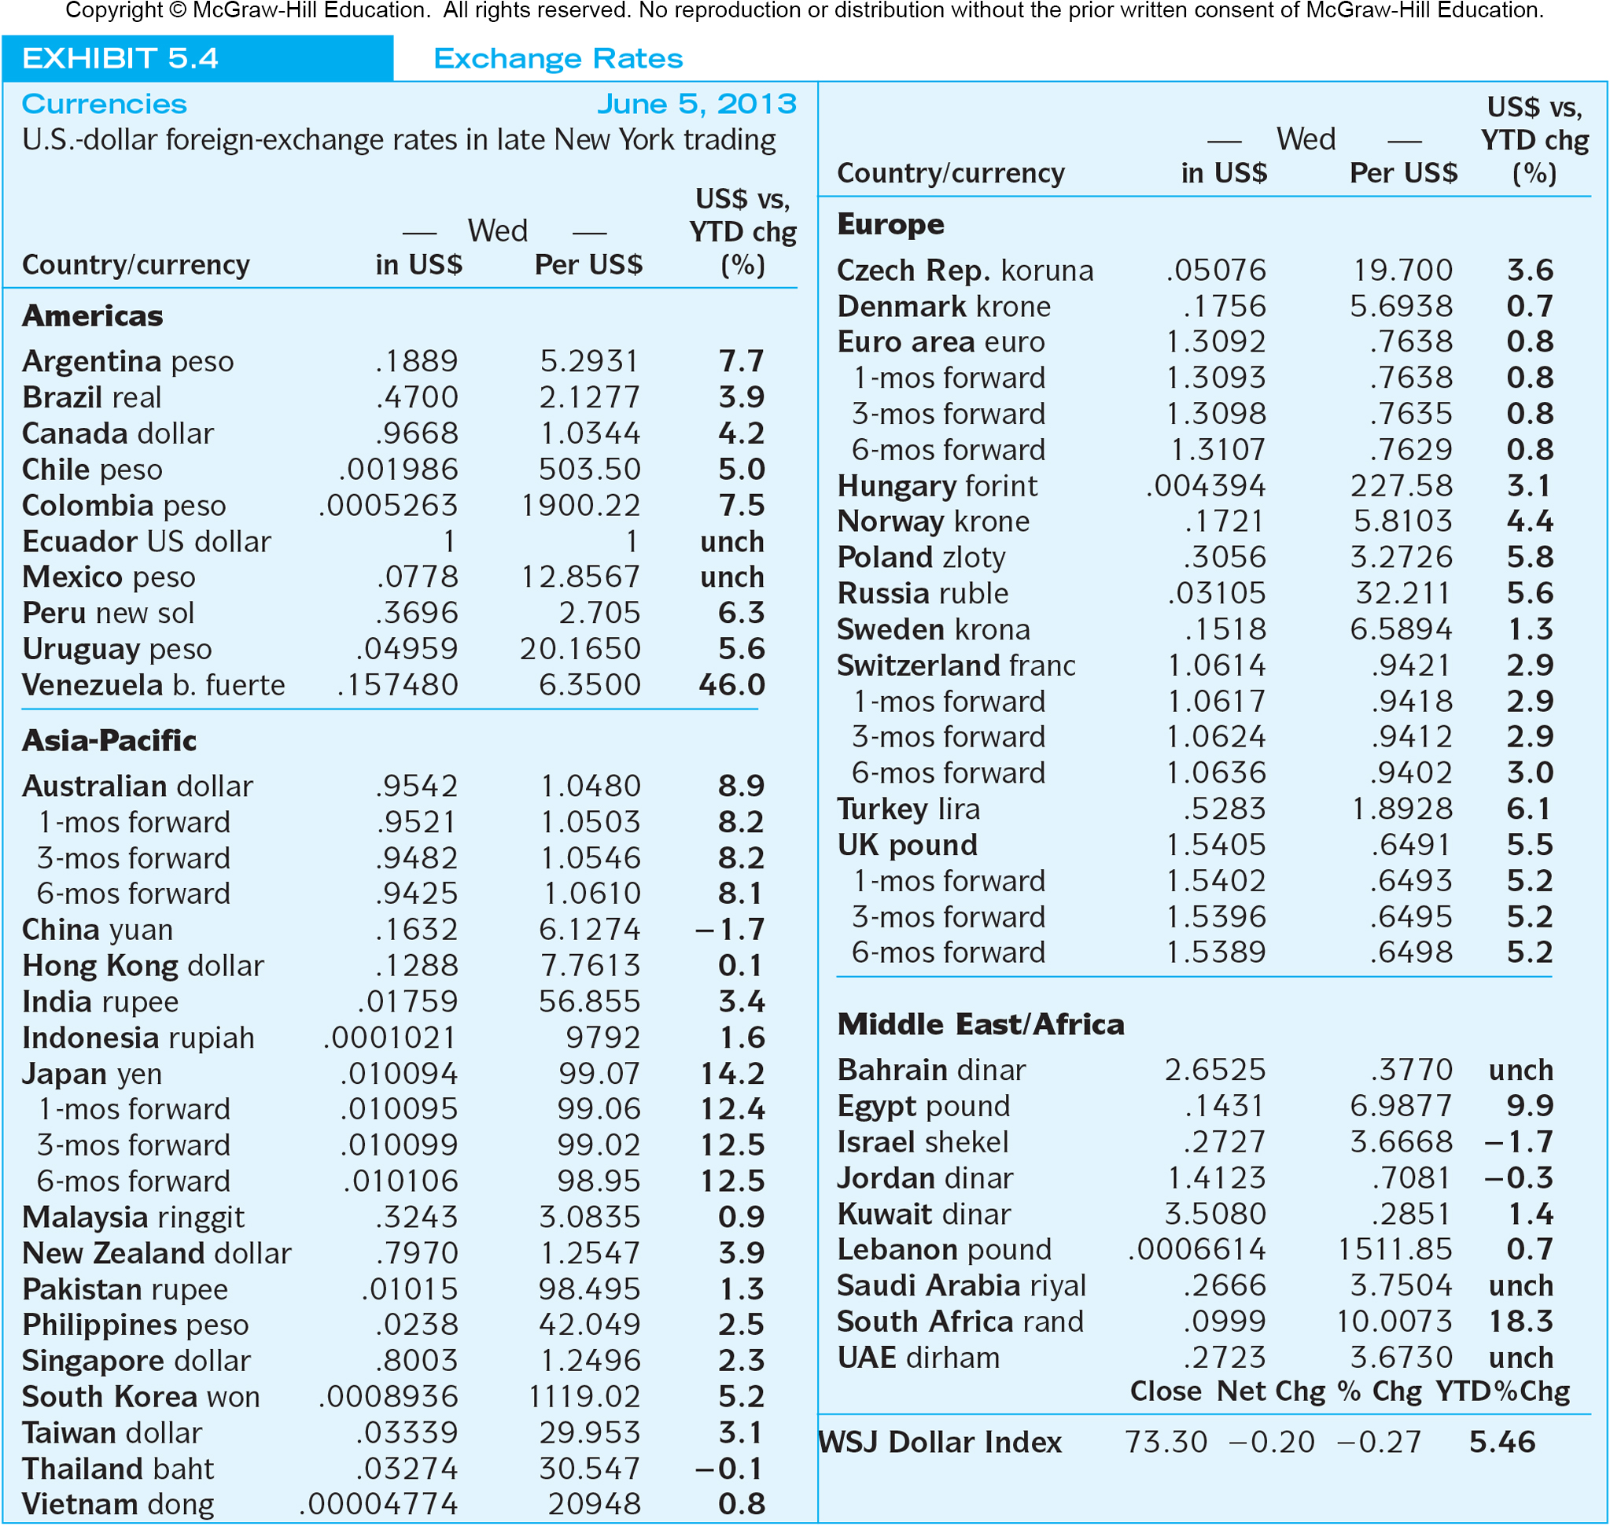
WSJ exchange rate reporting

Slide 18
Bid-ask spread
The bid price is the price a dealer is willing to pay you for something.
The ask price is the amount a dealer wants you to pay for something.
A dealer could:
  Bid £/$ = 0.6491; that is, pay £0.6491 for one $.
  Ask £/$ = 0.6494; that is, want you to pay £0.6494 for one $.
Bid < ask.
The spread is a source of revenue to the dealer.

Slide 19
Bid-ask quotation
A dealer pricing pounds in terms of dollars is likely to quote these prices as “00–05.”
Anyone trading $10m knows the big figure (i.e., 1.54)
USD Bank Quotations | American Terms |  | European Terms
 | Bid | Ask | Bid | Ask
Pounds | 1.5400 | 1.5405 | .6491 | .6494

Slide 20
Bid-ask reciprocal relationship
USD Bank Quotations | American Terms |  | European Terms
 | Bid | Ask | Bid | Ask
Pounds | 1.5400 | 1.5405 | .6491 | .6494
Notice that the reciprocal of the S($/£) bid is the S(£/$) ask.
$1,540
Dealer
Customer
£1,000
Customer sells pounds to dealer at direct bid
£.6494
£1.00
$1,000
=
Dealer
Customer
$1.00
$1.5400
£649.40
Buy USD from dealer at indirect ask

Slide 21
Example
A speculator in New York wants to take a $10,000 position in the pound.
The bid-ask quotes from a dealer: S($/£) = 1.5400-05 and S(£/$) = 0.6491- 94.
After this trade, what will be his/her position?
£ = $ × £/$ = 10,000 × 0.6491 = £6,491.
Why the worst price 0.6491, instead of 0.6494? This speculator is a customer, and the customer always gets the worse price; otherwise, the dealer will not have any revenue/profit.

Slide 22
Another example
A businessman has just completed transactions in England. He is now holding £500,000 and wants to convert it to U.S. dollars.
His currency dealer provides this quotation: GBP/USD = 0.6488-93.
$ = £ × $/£ = 500,000 × (1/0.6493) = $770,060.06.
Note that (1/0.6493) is a worse/lower ratio than (1/0.6488).

Slide 23
Cross rate trading
Cross rate: the exchange rate between two non-$ currencies.
Most interbank trading goes through the dollar.
Suppose that S($/€) = 1.50. Additionally, S($/£) = 2.00. What must the €/£ cross rate (in Euro terms) be?
€/£ = €/$ × $/£ = (1/1.50) × 2.00 = 1.3333.

Slide 24
Cross rate with bid-ask spreads
S$ (Singapore $) is quoted as S$/$ = 1.7438-48, ¥ is quoted as ¥/$ = 107.11-14. What is the ¥/S$ cross rate (in Japanese terms)?
¥/S$ = ¥/$ × $/S$.
4 possible combinations:
107.11 × (1/1.7438) = 61.423
107.11 × (1/1.7448) = 61.388 (smaller × smaller ➔ bid)
107.14 × (1/1.7438) = 61.441 (larger × larger ➔ ask)
107.14 × (1/1.7448) = 61.405
Pick the max and min: ¥/S$ = 61.388-441

Slide 25
Seemingly confusing quotation
Symbol: ¥/S$ (in the text) = 3-letter code: SGD/JPY (among practitioners) = “in Japanese terms.”
$/£ (in the text) = GBP/USD (in popular press and databases and some of the end-of-chapter questions) = “in American terms.”
For example, JPY/USD = 0.008972 on Bloomberg means “converting 1 JPY to 0.008972 USD” = $/¥ = in American terms.

Slide 26
Triangular arbitrage
Arbitrage: making sure money without taking any risk.
Triangular arbitrage: the process of trading out of the U.S. dollar into a second currency, then trading it for a third currency, which is in turn traded for U.S. dollar.
Today many trading rooms use algorithms that receives a digital feed of real-time FX prices to explore for triangular arbitrage opportunities.

Slide 27
Example
Consider the following bid-ask quotes.
Deutsche: €/$ = 0.7638-42.
Barclays: $/£ = 1.5400-04.
Based on the two quotes, the cross bid for €/£ = 0.7638 (smaller) × 1.5400 (smaller) = 1.1763.
If Citi wrongfully quotes €/£ = 1.1701-05, arbitrage opportunity arises. That is, £ is underpriced at Citi: the ask of 1.1705 is too low relative to the cross bid of 1.1763. Note that bid < ask.

Slide 28
Arbitrage process
Deutsche: €/$ = 0.7638-42.
Barclays: $/£ = 1.5400-04.
Citi: €/£ = 1.1701-05.
Process: (1) Through Deutsche, convert $1 into €0.7638; (2) Through Citi, convert €0.7638 into £0.6525 (0.7638 × 1/1.1705); Logic: taking advantage of Citi’s £ underpricing by going through € into £; (3) Through Barclays, convert £0.6525 into $1.0049 (0.6525 × 1.5400).
For this arbitrage, the outlay is $1 and the payoff is $1.0049. Thus the arbitrage profit is $0.0049.

Slide 29
Forward market
The forward market for FX involves agreements to buy and sell foreign currencies in the future at prices agreed upon today.
Bank quotes for 1, 3, 6, 9, and 12 month maturities are readily available for forward contracts.
Longer-term swaps are available.
Today’s forward rate reflects the current expectation of the market about the spot rate prevailing at the delivery day (in the future).

Slide 30
Forward rate quotations
Consider the exchange rates shown to the right. For British pounds, the spot exchange rate is $1.5405 = £1.00 while the 180-day forward rate is $1.5389 = £1.00
Country/currency | in US$ | per US$
UK pound | 1.5405 | .6491
1-mos forward | 1.5402 | .6493
3-mos forward | 1.5396 | .6495
6-mos forward | 1.5389 | .6498
Market participants expect that the pound will be worth less in dollars in six months.

Slide 31
Forward premium/discount
Suppose that S($/¥) = 0.010094 and F₃($/¥) = 0.010099 delivering in 94 days.
In American terms, the 3-month forward premium for ¥ is:
f_{N,j} = f_{3,¥} = {[F_{N}($/¥) – S($/¥)] / S($/¥)} × (360/days) = {[0.010099 – 0.010094] / 0.010094} × (360 /94) = 0.19%.
¥ is trading at a 0.19% premium versus the $ for delivery in 94 days.
The market expects ¥ to appreciate relative to $; that is, the market expects $ to depreciate relative to ¥.

Slide 32
Forward premium/discount
It must be true that, in European terms, S(¥/$) = 99.07 and F₃(¥/$) = 99.02 delivering in 94 days.
In European terms, the 3-month forward discount for $ is:
f_{N,$} = f_{3,$} = {[F_{N}(¥/$) – S(¥/$)] / S(¥/$)} × (360/days) = {[99.02 – 99.07] / 99.07} × (360 /94) = -0.19%.
$ is trading at a -0.19% discount versus the ¥ for delivery in 94 days.
The market expects $ to depreciate relative to ¥.

Slide 33
Long and short positions
If you have agreed to sell anything (spot or forward), you are taking a “short” position.
If you have agreed to buy anything (forward or spot), you are “long.”
That is, if you have agreed to sell an FX forward, you are shorting, and if you have agreed to buy an FX forward, you are taking a long position.

Slide 34
A speculative forward position
Consider the following quotes: S(¥/$) = 101.00 and F₃(¥/$) = 101.55.
Suppose your research suggests that the spot rate for ¥/$ in three months will be 103.00.
Trading: you sell (short) ¥ forward contract against $ today.
If you are right, ¥/$ becomes 103.00 in three months. You buy spot at that time: convert $1 into ¥103. You then deliver ¥101.55 on your forward to obtain $1.
The trading profit is ¥1.45.
Note that this speculative short trade involves risk. You make (loss) money if the spot ¥/$ three months later is higher (lower) than the forward ¥/$ today.

Slide 35
Non-deliverable forward (NDF) contracts
Due to government capital controls, the currencies of some emerging market countries are not freely traded.
For many of these currencies, trading in non-deliverable forward contracts exists.
A non-deliverable forward contract is settled in cash, usually U.S. dollars.
Notes:
If JPY forward were non-deliverable forward, the settlement in the previous slide would be JPY1.45 or, equivalently, USD(1.45/103).

Slide 36
An example of NDF
“RMB non-deliverable forward (NDF), a kind of cash settled foreign exchange forward contract between customer and BOC Macau on USD/CNY, where the net gain or loss is settled in USD at the settlement date by taking the difference between the agreed upon forward exchange rate and the fixing spot rate at the maturity date, for an agreed upon notional amount. Customer can buy or sell USD/CNY without physical delivery of notional amount and with only cash settled gain or loss in USD.”
Source: Bank of China

Slide 37
Forward cross rate
Forward cross rates are calculated in an analogous manner to spot cross rates.

Slide 38
Exchange-traded currency funds
Individual shares are denominated in the U.S. dollar and trade on the New York Stock Exchange.
  Consider an ETF where each share represents 100 euros. The price of one share at any point in time will reflect the spot dollar value of 100 euros plus accumulated interest minus expenses.
  FXE: Guggenheim CurrencyShares Euro Trust
A number of additional currency trusts exist on the Australian dollar, British pound sterling, Canadian dollar, Mexican peso, Swedish krona, and the Swiss franc.
Currency is now recognized as a distinct asset class, like stocks and bonds. Currency ETFs facilitate investing in these currencies.

Slide 39
Forward point quotation
Forward rates are often quoted in terms of forward points.
When the second number in a forward point pair (say the forward pair of “3 – 1” for one-month forward) is smaller than the first ( 1 < 3), investors know they are dealing with forward discount. Thus, the forward points are subtracted from the spot bid and ask prices to obtain the outright forward rates.
CHF/USD spot | .9421 - .9424
1-month | 3 - 1
3-month | 9 - 5
6-month | 19 - 13

Slide 40
Outright forward quotations
 | Forward point | Outright quotation
CHF/USD spot |  | .9421 - .9424
1-month | 3 - 1 | .9418 - .9423
3-month | 9 - 5 | .9412 - .9419
6-month | 19 - 13 | .9402 - .9411

Slide 41
Forward premium
When the second number in a forward point pair is larger than the first, investors know they are dealing with forward premium. Thus, the forward points are added to the spot bid and ask prices to obtain the outright forward rates.

Slide 42
Outright quotation
 | Forward point | Outright quotation
$/€ spot |  | 1.3331-32
1-month | 1 - 2 | 1.3332-34
3-month | 4 - 6 | 1.3335-38
6-month | 8 - 12 | 1.3339-44

Slide 43
End-of-chapter
Questions: 1-6, 8-10
Problems: 1-13.

